Slide 1

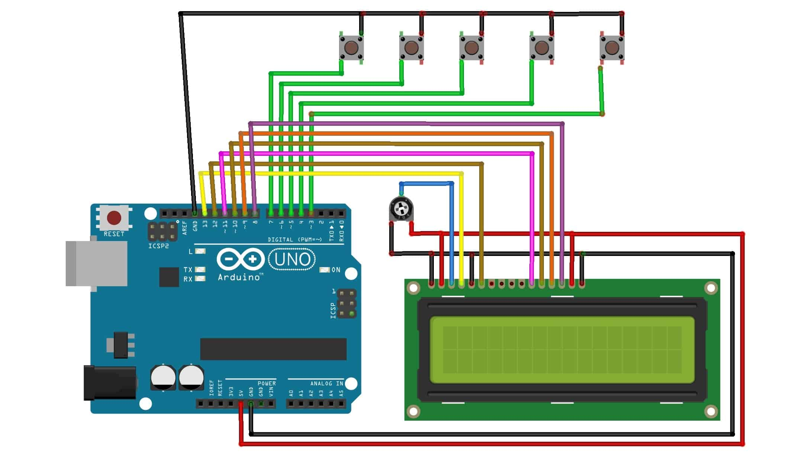
Arduino-based voting machine
In this presentation, we will explore the concept of an Arduino-based voting machine, which combines the simplicity and versatility of the Arduino microcontroller with the latest advancements in electronic voting technology

Slide 2
Table of contents
01
02
03
Introduction
Background
Circuit Diagram
04
05
06
Components and Materials
Code
User Interface
07
08
Results
Conclusion

Slide 3
Introduction
This project is all about Simple & Smart Electronic Voting Machine Using Arduino. The basic idea of this project is to create an electronic voting machine that will help to eradicate defrauding of the manual voting systems and prior versions of electronic voting. The system is provided with n number of the switch where n is the number of a political party. Here the voter will be allowed to proceed for choosing their preferred candidate from the panel of buttons. The final vote is then displayed onto an LCD for the satisfaction of voters. In the end, the result can be automatically calculated by pressing the result button.

Slide 4
BACKGROuND
The Arduino project started at the Interaction Design Institute Ivrea in Italy as a Master's thesis project to create low-cost tools for non-engineers to create digital projects. The original platform, Wiring, used an ATmega168 microcontroller and an IDE based on Processing, but was later forked and renamed as Arduino. The first Arduino boards used the FTDI USB-to-serial driver chip and an ATmega168. The Arduino Uno, the first widely-used version, featured the ATmega328P microcontroller and an ATmega16U2 programmed as a USB-to-serial converter, which distinguished it from earlier boards.

Slide 5
CIRCUIT DIAGRAM

Slide 6
Components and Materials
Arduino UNO Board.
16x2 LCD Display.
Potentiometer 10k.
Push Button Switch.
Connecting Wires.
PCB.
5V adaptor

Slide 7
CODE
lcd.clear();
lcd.print("CON is Winner");
delay(3000);
lcd.clear();
}
else if((vote3 > vote1 && vote3 > vote2 && vote3 > vote4))
{
lcd.clear();
lcd.print("AAP is Winner");
delay(3000);
lcd.clear();
}
else if(vote4 > vote1 && vote4 > vote2 && vote4 > vote3)
{
lcd.setCursor(0,0);
lcd.clear();
lcd.print("BJD is Winner");
delay(3000);
lcd.clear();
}
else if(vote4 > vote1 && vote4 > vote2 && vote4 > vote3)
{
lcd.setCursor(0,0);
lcd.clear();
lcd.print("D is Winner");
delay(3000);
lcd.clear();
}
else
{
lcd.clear();
lcd.print(" Tie Up Or ");
lcd.setCursor(0,1);
lcd.print(" No Result ");
delay(3000);
lcd.clear();
}
}
else
{
lcd.clear();
lcd.setCursor(1,0);
lcd.print("BJP");
lcd.setCursor(1,1);
lcd.print(vote1);
lcd.setCursor(5,0);
lcd.print("CON");
lcd.setCursor(5,1);
lcd.print(vote2);
lcd.setCursor(9,0);
lcd.print("AAP");
lcd.setCursor(9,1);
lcd.print(vote3);
lcd.setCursor(13,0);
lcd.print("BJD");
lcd.setCursor(13,1);
lcd.print(vote4);
if(digitalRead(S1)==0)
vote1++;
while(digitalRead(S1)==0);
if(digitalRead(S2)==0)
vote2++;
while(digitalRead(S2)==0);
if(digitalRead(S3)==0)
vote3++;
while(digitalRead(S3)==0);
if(digitalRead(S4)==0)
vote4++;
while(digitalRead(S4)==0);
if(digitalRead(S5)==0)
{
int vote=vote1+vote2+vote3+vote4;
if(vote)
{
if((vote1 > vote2 && vote1 > vote3 && vote1 > vote4))
{
lcd.clear();
lcd.print("BJP is Winner");
delay(3000);
lcd.clear();
}
else if((vote2 > vote1 && vote2 > vote3 && vote2 > vote4))
{
#include<LiquidCrystal.h>
LiquidCrystal lcd(2,3,4,5,6,7);
#define S1 A0
#define S2 A1
#define S3 A2
#define S4 A3
#define S5 A4
int vote1=0;
int vote2=0;
int vote3=0;
int vote4=0;
void setup()
{
pinMode(S1, INPUT);
pinMode(S2,INPUT);
pinMode(S3,INPUT);
pinMode(S4,INPUT);
pinMode(S5,INPUT);
lcd.begin(16, 2);
lcd.print(" Electronic ");
lcd.setCursor(0,1);
lcd.print(" Voting Machine ");
delay(4000);
digitalWrite(S1, HIGH);
digitalWrite(S2, HIGH);
digitalWrite(S3, HIGH);
digitalWrite(S4, HIGH);
digitalWrite(S5, HIGH);
lcd.clear();
lcd.setCursor(1,0);
lcd.print("BJP");
lcd.setCursor(5,0);
lcd.print("CON");
lcd.setCursor(9,0);
lcd.print("AAP");
lcd.setCursor(13,0);
lcd.print("BJD");
}
void loop()
{
lcd.print("No Voting....");
delay(3000);
lcd.clear();
}
vote1=0;vote2=0;vote3=0;vote4=0,vote=0;
lcd.clear();
}
}

Slide 8
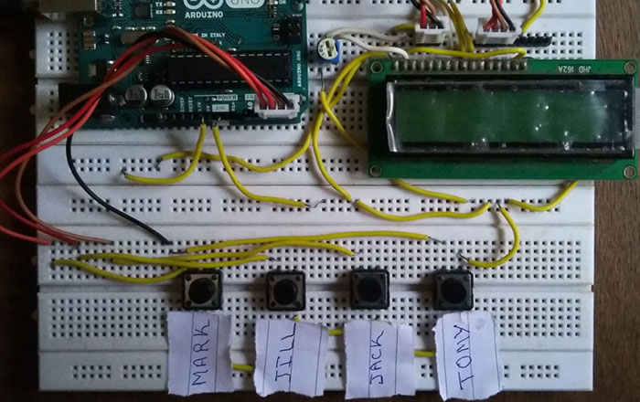
User Interface

Slide 9
RESULT
"The Arduino-based voting machine that we have developed is a cost-effective, secure, and accurate solution for conducting elections. The machine has been tested extensively and has been found to be reliable and user-friendly.
Some of the key features of the machine include:
Easy-to-use interface: The machine has a simple and intuitive interface that allows voters to cast their votes easily and quickly.
Secure voting process: The machine uses encryption to ensure that the voting process is secure and the votes are kept confidential.
Accurate vote counting: The machine uses a sophisticated algorithm to count the votes accurately, and the results can be easily viewed and verified.
Low cost: The machine is cost-effective as compared to traditional electronic voting machines, making it a viable option for smaller elections and communities.
Overall, the Arduino-based voting machine is a promising solution for conducting secure, accurate, and transparent elections. We believe that this technology has the potential to revolutionize the way we vote and could help to increase voter turnout and participation in elections."

Slide 10

CONCLUSION
"In conclusion, the Arduino-based voting machine is a innovative solution for conducting secure, accurate, and transparent elections. By combining the simplicity and versatility of the Arduino microcontroller with the latest advancements in electronic voting technology, this machine offers a cost-effective alternative to traditional electronic voting machines.
The machine has been tested and found to be reliable, user-friendly, and secure. It has the potential to revolutionize the way we vote and increase voter turnout and participation in elections.
We hope that this presentation has provided you with a comprehensive understanding of the Arduino-based voting machine and its potential to improve the electoral process. Thank you for your time and attention."

Slide 11
It's so lovely
to meet all
of you!
Thank you for listening.

